Slide 1
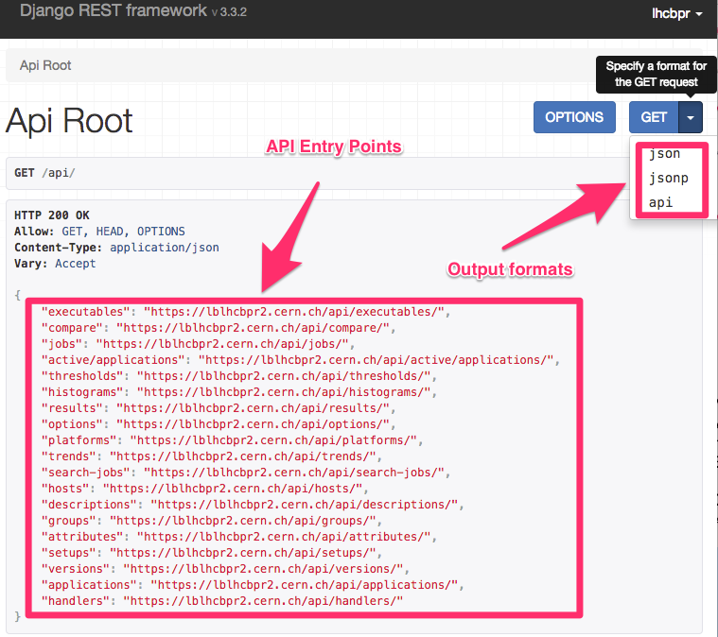
Microservices for Systematic Profiling and Monitoring of the Refactoring
Alexander Mazurov, Ben Couturier
LHCb Performance and Regression Tests (LHCbPR) - systematize profiling that helps developers to evaluate how their recent code changes behave in provided test cases for different setup environments.
Main use cases
Physics performance
Histogram comparison
Trend analysis for selected attribute.
Monitor regression in memory and CPU consumption
Possible setup environments
Versions of application
Compiler versions
Operating Systems (SLC6, CentOS7)
Architecture (x86_64, x86)
Build system (CMT or CMake)
LHCbPR not coupled to the LHCb software stack and can be adapted for other experiments and projects
We are working on extending repository of web components and analysis modules for web frontend.
Easy to develop new clients for API service.
 | Geant v96r4 | Geant v10r2
CMT | x | x
CMake | x | x
SLC6 | x | x
CentOS7 | x | x
X86_64 optimized | x | x
X86_64 debug | x | x

Slide 2
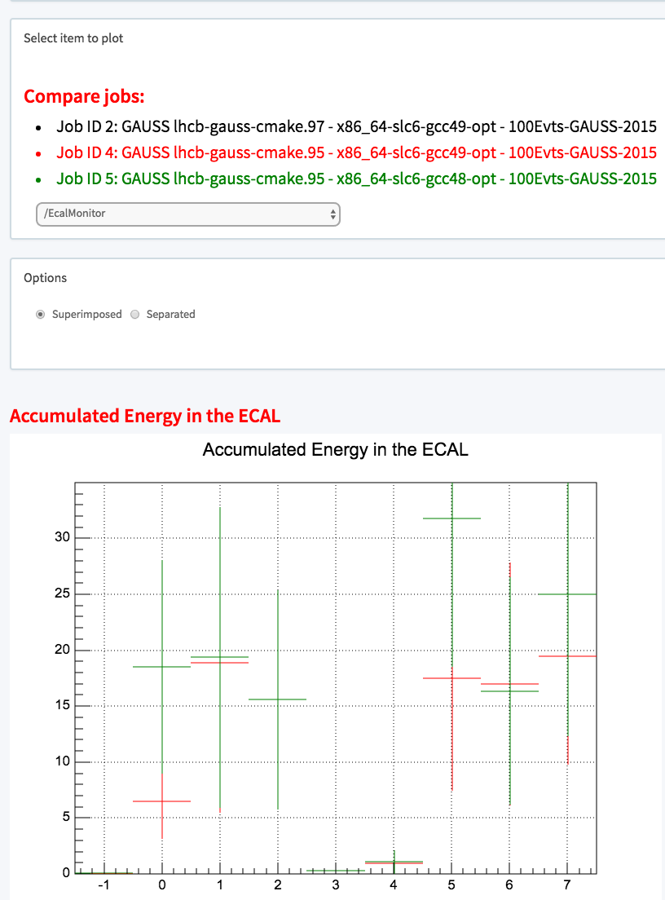
Deployment
API Service
Web Frontend
CHEP 2016

